Slide 1
Human Emotion Recognistion
Presented by:
Harsh Artwani - 1001953350
Gaurav Taneja - 1001955801

Slide 2
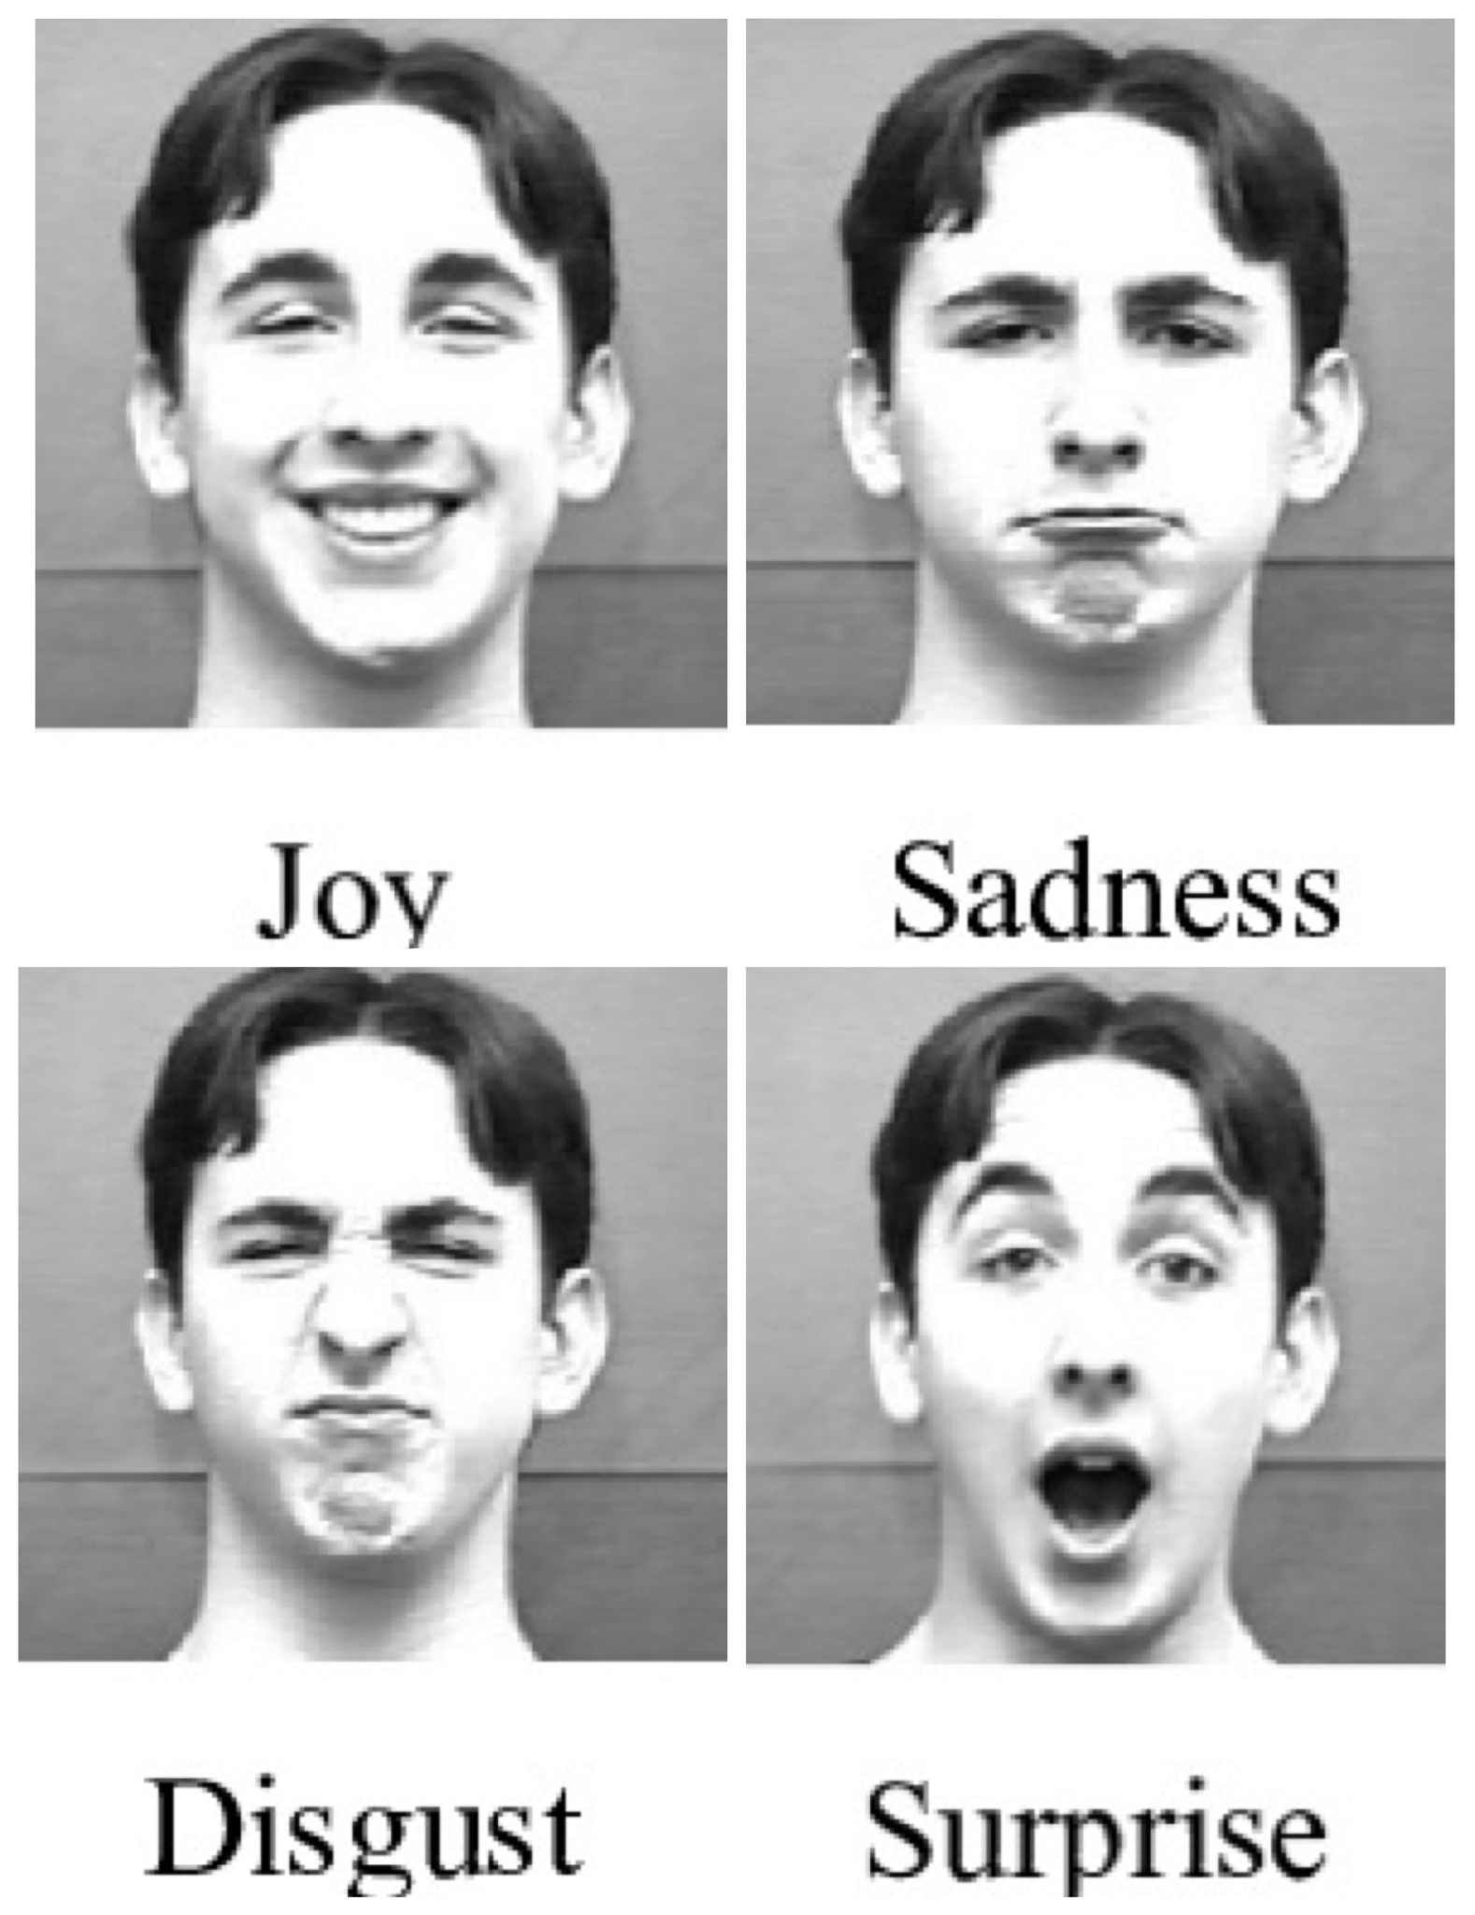
Objective:
To develop a realtime software that could predict human emotion using face detection.
The following emotions are considered:
Neutral
Happy
Sad
Anger
Disgust
Fear
Surprise

Slide 3
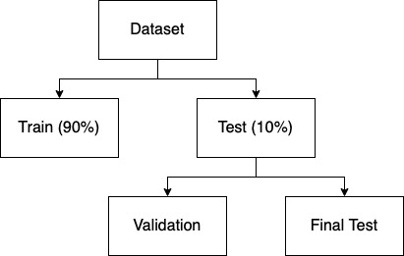
Dataset Preprocessing
Dataset used: Fer2013

Slide 4
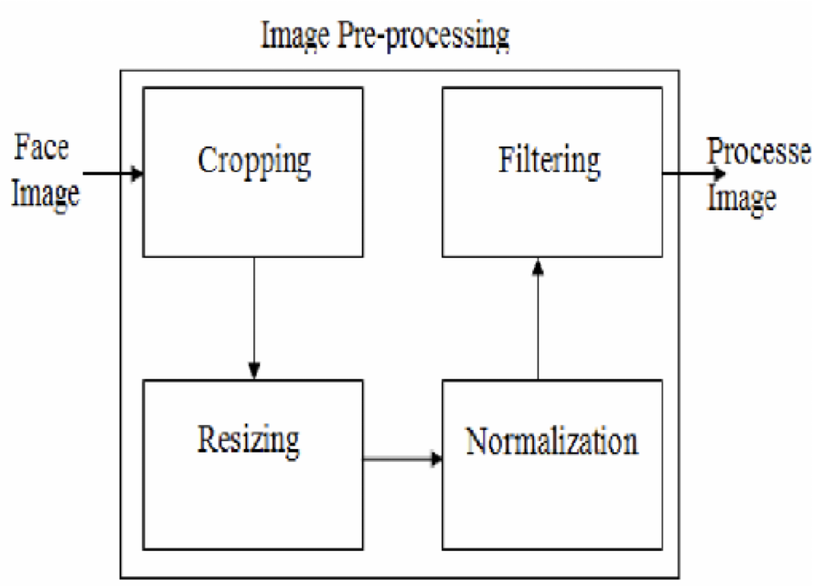
Image Preprocessing:
Cropping
Grayscale Conversion
Image Resizing
Normalization

Slide 5
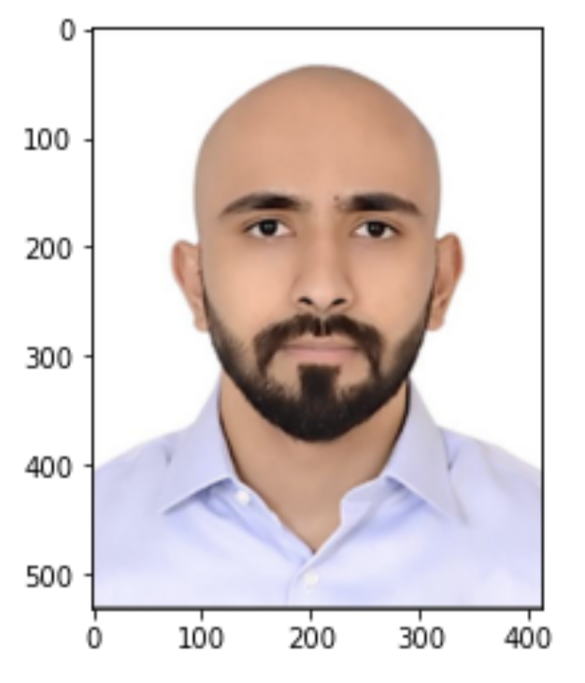
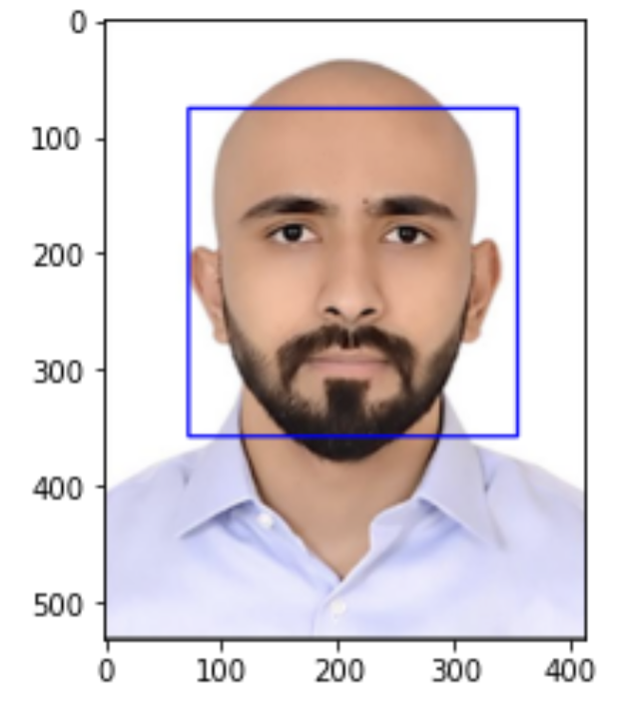
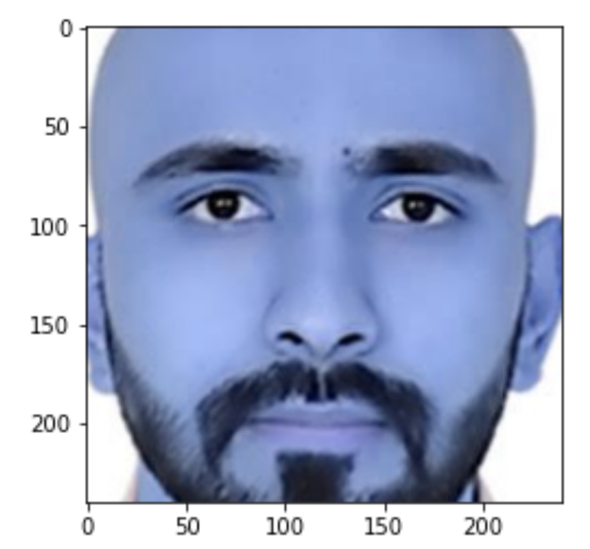
Image Preprocessing: (Example)
—----> —---->

Slide 6
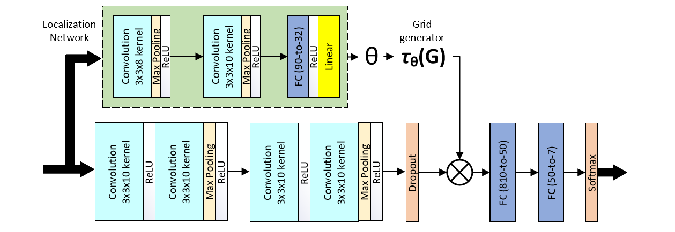
Model:

Slide 7
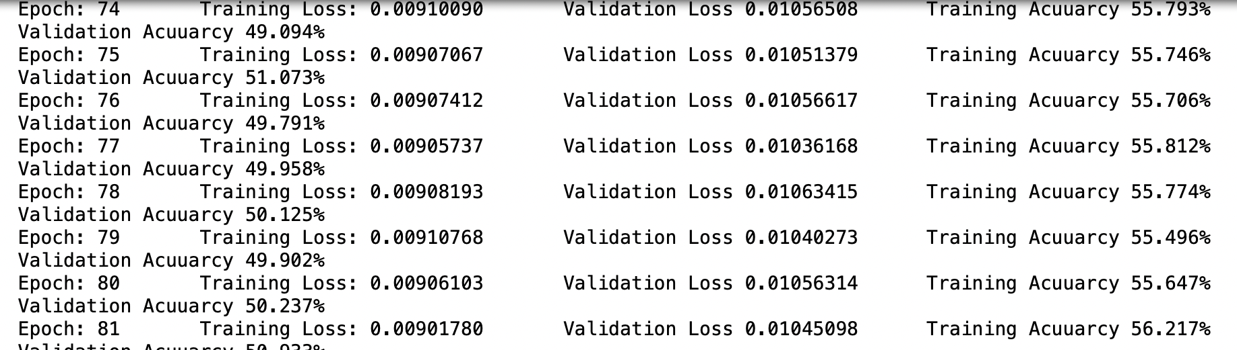
Epochs:

Slide 8
Reference:
https://arxiv.org/pdf/1902.01019.pdf
https://scholarworks.sjsu.edu/cgi/viewcontent.cgi?referer=&httpsredir=1&article=1322&context=etd_projects
https://www.analyticsvidhya.com/blog/2019/11/4-tricks-improve-deep-learning-model-performance/

Slide 9
Thank you!

